Slide 1

DAYANANDA SAGAR COLLEGE OF ENGINEERING (An Autonomous Institute affiliated to VTU, Belagavi – 590018, Approved by AICTE & ISO 9001:2008 Certified) Accredited by National Assessment & Accreditation Council (NAAC) with ‘A’ grade & NBA DEPARTMENT OF ELECTRICAL AND ELECTRONICS ENGINEERING
Battery monitoring System using Machine Learning
Submitted by
ADITYA AGARWAL 1DS21EE009
ANKIT KUMAR JADOUN 1DS22EE015
ANKUSH PAL 1DS22EE016
ARJUN CHAUHAN 1DS22EE019
Under the Guidance of :
Mrs. SHRUTI R.G
Assistant Professor
Dept. of EEE,
DSCE, Bengaluru

Slide 2
ABSTRACT
Battery technology used in Electric Vehicles has recently drawn numerous researchers’ attention. Monitoring of battery condition, especially the state of charge, is necessary to ensure the safe and reliable operation of the battery.
Deep learning (DL) is a well-known machine learning strategy that has been shown to outperform many other approaches for SOC estimation in recent studies.
choosing the right hyperparameters and appropriate use of suitable input parameters is crucial to get the best performance out of DL models
In addition to that, average voltage and average current are used as the important input parameters along with battery parameters (current, voltage and temperature) for accurate SOC prediction as they involve the past and present history of voltages and load conditions, respectively.
Currently, researchers use well-established heuristics approaches to choose hyperparameters by manual tuning or using thorough search techniques like grid search and random search. This leads the models to be inefficient and less accurate. This paper suggests a methodical, automated procedure for choosing hyperparameters using ML algorithm. In addition to that, average voltage and average current are used as the important input parameters along with battery parameters (current, voltage and temperature) for accurate SOC prediction as they involve the past and present history of voltages and load conditions, respectively.

Slide 3
INTRODUCTION
The renewable energy sources require an energy storage system (ESS) to support a reliable and smooth supply to the customer.
Among different energy storage systems, Li-ion battery is preferred over other batteries in many fields owing to its high reliability, efficiency, power and energy density, long lifespan and low discharge rate.
The BMS senses the voltage and current of the battery cells and its corresponding temperature to prevent over-charge and over-discharge conditions which occurs when the battery is connected to a load. These measured variables are employed in estimating the Li-ion battery states i.e., the State of available Power (SOP), State of Charge (SOC), State of Life (SOL) and State of Health (SOH).
ML could be a promising modeling approach to estimate the SOH, SOC and remaining useful life of batteries.
This project will help Unmanned Ariel Vehicle (UAV)s, Electric Vehicle (EV)s, inverters and other battery-operated devices to function smoothly for a long time.

Slide 4
LITERATURE SURVEY
Over the past decades, numerous SOC estimation techniques have been proposed. The coulomb counting approach and the lookup table method are the strategies that are considered to be conventional techniques.
In modern times, data-based SOC estimation techniques have been highly preferred by researchers for accurate SOC prediction.
Since SOC estimation approaches based on deep learning can directly map sampled battery operational signals (e.g., current and voltage) to SOC and eliminate the necessity of laborious battery modelling or feature engineering, researchers are carrying out intense research in this field
DL algorithms are highly preferred in various disciplines of EV applications, namely in energy management, prediction of charging demand, estimation of SOH, vehicle detection cell balancing ,thermal management, and so on.
The estimation of SOC based on DL algorithms not only depends on the optimal hyperparameter selection but also the correlation of input parameters with the output SOC. It is observed that most of the researchers have considered only battery voltage, current and temperature as the input parameters for the estimation of SOC. Though these methods have shown encouraging results, there is still room for development as these models have only taken into account a portion of the variables that could influence predictions and have not taken environmental factors into account.
the ML optimisation technique is used for the optimal selection of hyperparameters that provide increased flexibility and a unified model capable of predicting SOC more accurately under varying ambient temperatures.
Author :SELVARAJ VEDHANAYAKI AND VAIRAVASUNDARAM INDRAGANDHI

Slide 5
OBJECTIVES
1. State of Charge (SOC) Estimation
Accurately estimate the remaining charge in the battery.
2. State of Health (SOH) Estimation
Assess the health and remaining useful life (RUL) of the battery.
3. Remaining Useful Life (RUL) Prediction
Predict how long the battery will last before it fails or requires replacement.
4. Anomaly Detection
Detect unusual patterns or behaviors in the battery that may indicate faults, degradation, or safety risks.
5. Optimal Charging and Discharging Management
Optimize charging and discharging cycles to extend battery life and improve efficiency.

Slide 6
6. Thermal Management
Predict and manage the thermal behavior of the battery to prevent overheating and ensure safe operation.
7. Energy Management
Optimize energy usage in systems with multiple batteries or battery cells, balancing load and ensuring efficient energy
distribution.
8. Failure Prediction and Preventive Maintenance
Predict potential failures or degradation points in the battery system to enable preventive maintenance.
9. Personalized Battery Usage Profiles
Customize battery usage based on user behavior and environmental conditions.

Slide 7
METHODOLOGY
Define Objectives and System Requirements:
Establish the goals of the BMS (e.g., SOC, SOH prediction) and determine necessary hardware and software components
Data Collection and Preprocessing:
Gather and clean data from sensors monitoring battery parameters like voltage, current, and temperature.
Feature Engineering and Model Development:
Extract relevant features, select suitable machine learning models, and train the models on the preprocessed data.
Model Evaluation and Optimization: Validate the model using cross-validation, and fine-tune it through hyperparameter optimization.
Integration and Real-Time Monitoring: Embed the trained model into the BMS hardware and implement real-time monitoring for continuous battery assessment.
Deployment and Continuous Improvement: Deploy the BMS in the target application, monitor its performance, and update the system with new data and software improvements.

Slide 8
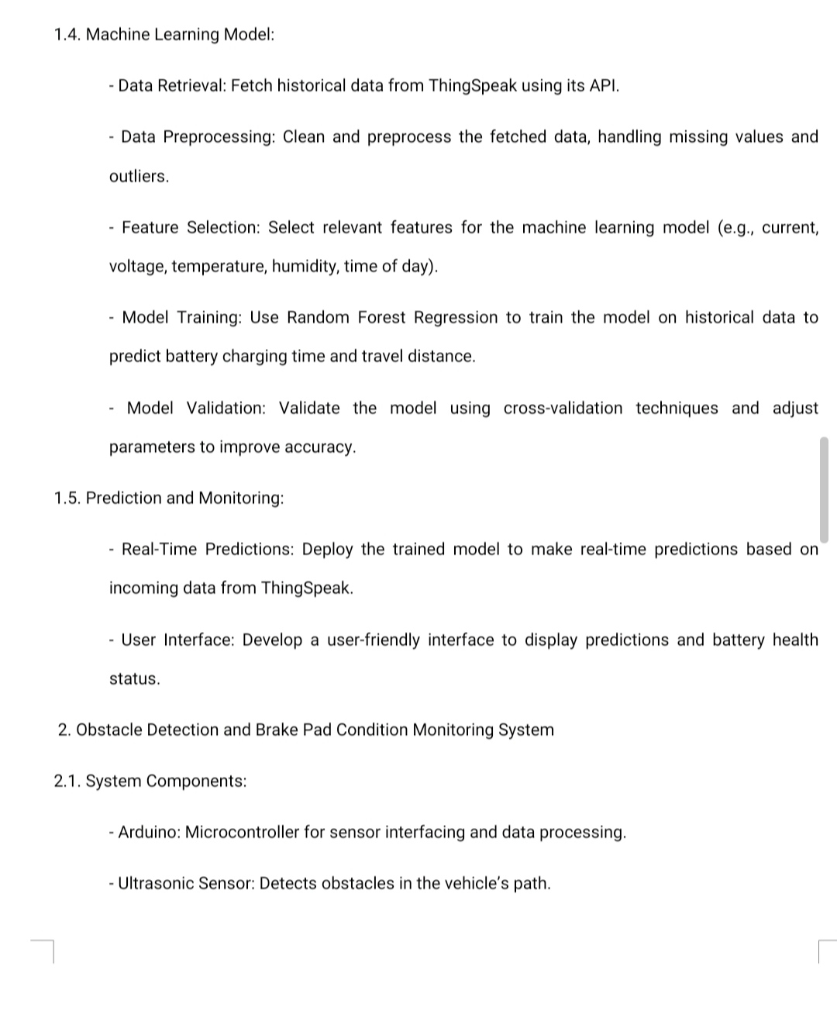

Slide 9
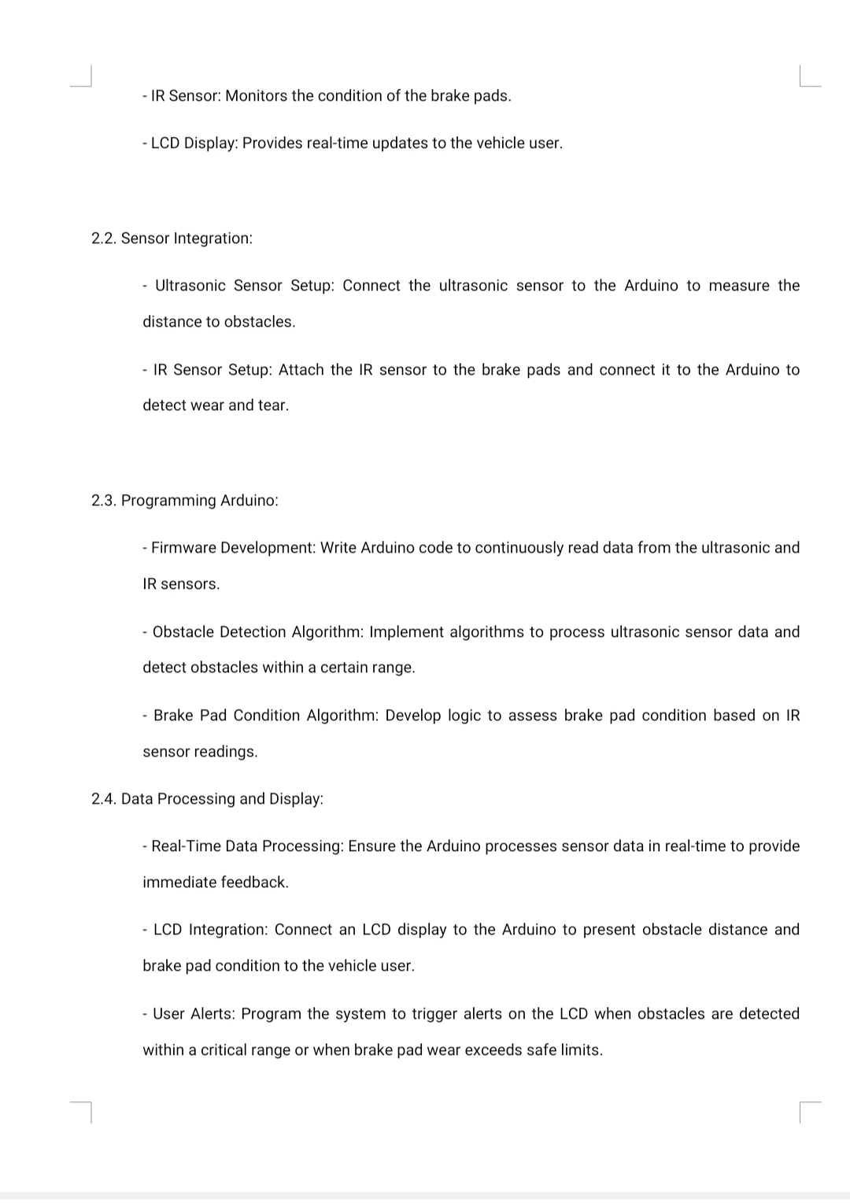

Slide 11
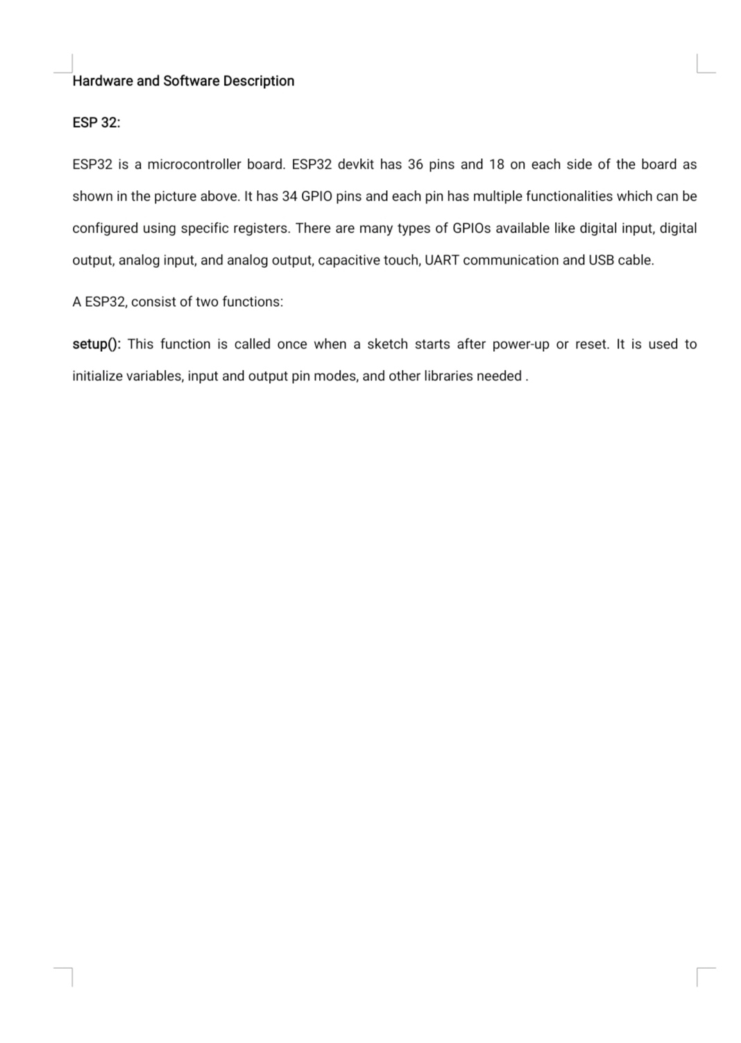

Slide 12
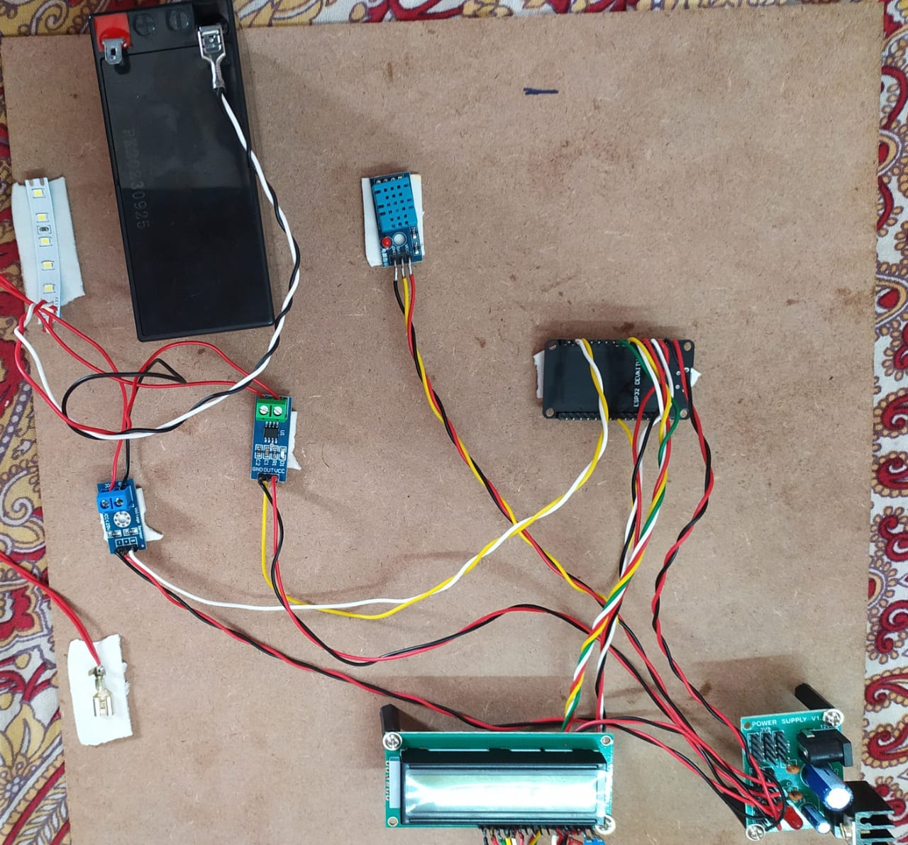
Final Output - 40% of The Project

Slide 13
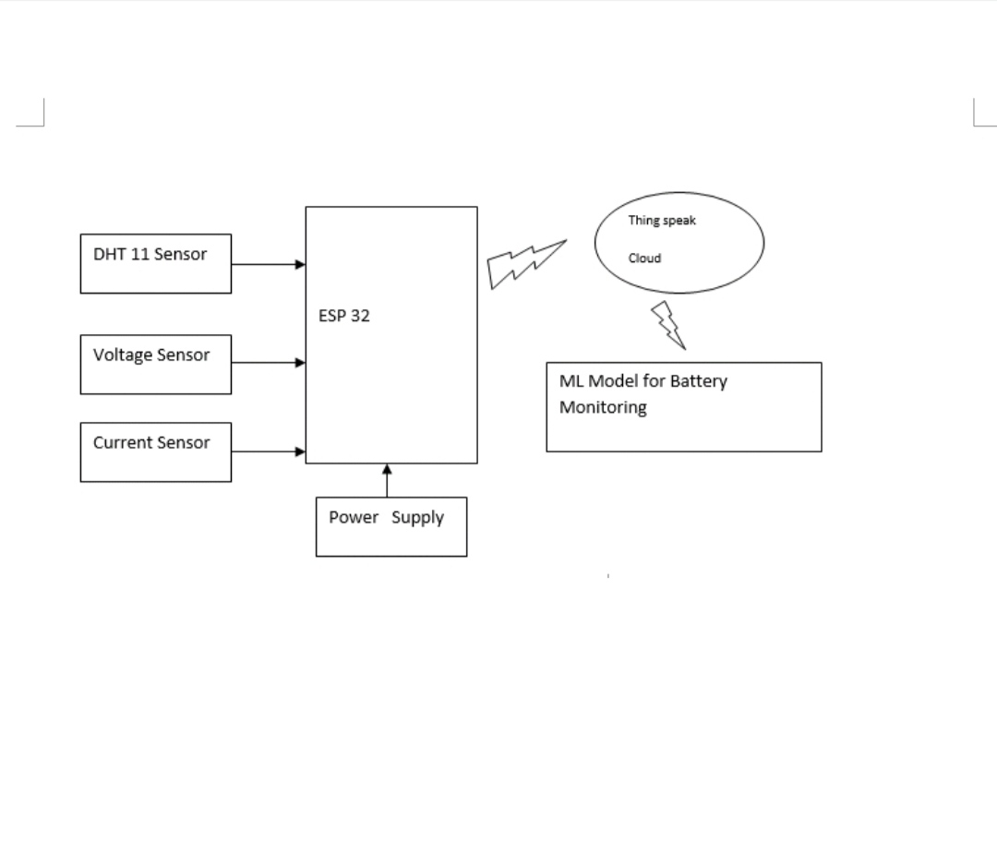
Circuit Diagram

Slide 14
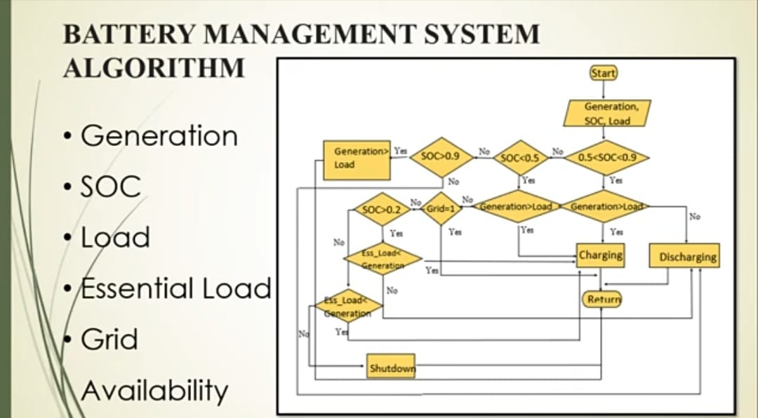

Slide 15
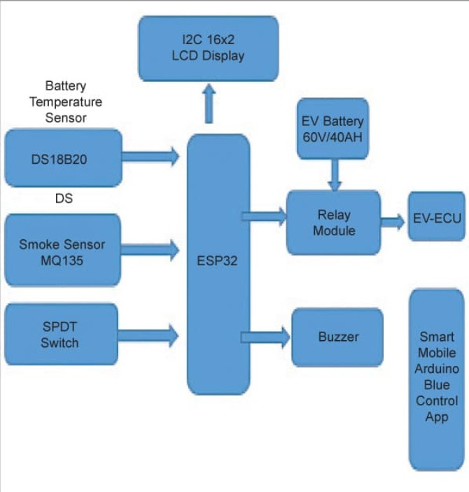
BLOCK DIAGRAM

Slide 16
EXPERIMENTAL SETUP
HARDWARE REQUIREMENTS:
VOLTAGE SENSOR
CURRENT SENSOR
TEMPERATURE SENSOR
ESP 32
LCD Display 16x2
SOFTWARE REQUIREMENTS:
Jupyter Notebook, google colab
PYTHON(MACHINE LEARNING)
WINDOWS

Slide 17
REFERENCES
[1] M. Lennan and E. Morgera, ‘‘The Glasgow climate conference (COP26),’’
Int. J. Mar. Coastal Law, vol. 37, no. 1, pp. 137–151, 2022.
[2] Y. Khawaja, N. Shankar, I. Qiqieh, J. Alzubi, O. Alzubi,
M. K. Nallakaruppan, and S. Padmanaban, ‘‘Battery management
solutions for Li-ion batteries based on artificial intelligence,’’ Ain Shams
Eng. J., vol. 14, no. 12, 2023, Art. no. 102213.
[3] R. Irle, ‘‘EV-volumes-The electric vehicle world sales database,’’ Glob. EV
Sales, 2021.
[4] F. Nadeem, S. M. S. Hussain, P. K. Tiwari, A. K. Goswami, and T. S. Ustun,
‘‘Comparative review of energy storage systems, their roles, and impacts
on future power systems,’’ IEEE Access, vol. 7, pp. 4555–4585, 2019.
[5] V. Selvaraj and I. Vairavasundaram, ‘‘Flyback converter employed
non-dissipative cell equalization in electric vehicle lithium-ion batteries,’’ e-Prime-Adv. Elect. Eng., Electron.

Slide 18
Thank you

